Slide 1
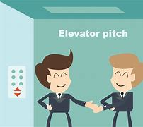
Elevator Pitch
By:
Mr. Mukesh Mahay

Slide 2
What is an elevator pitch
If you can introduce your self to effectively demonstrate your strengths, skills, professional aptitude in time limit 60-90 seconds.
Introduction(Greeting,Name)
Summary(Strengths , skills, USP, Justifications, goal etc)
Your expectation and closing

Slide 3
Key positive points
Strengths: Internal characteristics of a person give it an advantage over others.
Opportunities: Platforms/ elements in the environment that could exploit to its advantage.

Slide 4
How to develop a USP
Identify the strengths , skills:
ALL of your skills. What are you good at? Inside and outside of work.
What you’ve learned. Have you taken any specific courses? Been trained by professionals? Learnt on the job? ALL of your experience. List all of the jobs you’ve had in the past, including part-time and voluntary positions
2. Tailor your USP : Which skills, knowledge and experience would be relevant to the industry?
Eg Innovation , coding ,problem solving etc.(Like Problem solving in Amazon for the career)
3 .Focus on the benefits : Are you worth the time, hassle and money?
4. Prove it: Put the statistics , numbers like projects, certificates
5. Create a wow: Do not doubt and be confident
\

Slide 5
Do’s and Don'ts' in the elevator pitch
It is like an introduction but focus is on branding your self with your skills, strengths, USP, Goal, passion, achievements , accomplishments, hobbies, feedback from someone, Project, internship, certificate, Role model or your aspiration etc
DO’s
Your elevator speech should be brief: Restrict the speech to 60- 90 seconds. greetings, your name, project or assignment , accomplishment, USP, strength ,certifications with EXAMPLE in precise way JUSTIFY ALL THE SKILLS , STRENGTH,USP with example. FOCUS ON THE JOB DESCRIPTION
You need to be persuasive : Should be compelling enough to spark the listener' interest in your idea CALL TO ACTIO
Share your skills. Your elevator pitch should explain who you are and what qualifications and skills you have
Practice, practice, practice PROJECT Must be there (aim, details, outcome)
Don'ts
DO not explain the examples it must be precise, NO weakness and no negative statements
DO not extend the time, DO NOT USE MYSELF is
Do not speak about home town, education , family details
Do not say thanks for giving opportunity.
No cliché Like Hardwork , No slangs- like Gonna , Jargons- like TP( Think Pad)

Slide 6
Call to action
Job description : Data analyst
Pitch : ‘If this is the sort of person you are looking for who can visualize, have solution approach
Examples : Projects, certification
Remember : COMMUNICATION SKILLS MUST NOT BE IMPACTED

Slide 7

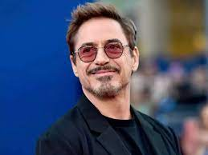

Connect and grow
A
B
C

Slide 8

Notes:
Thank you and see you soon!

